Slide 1

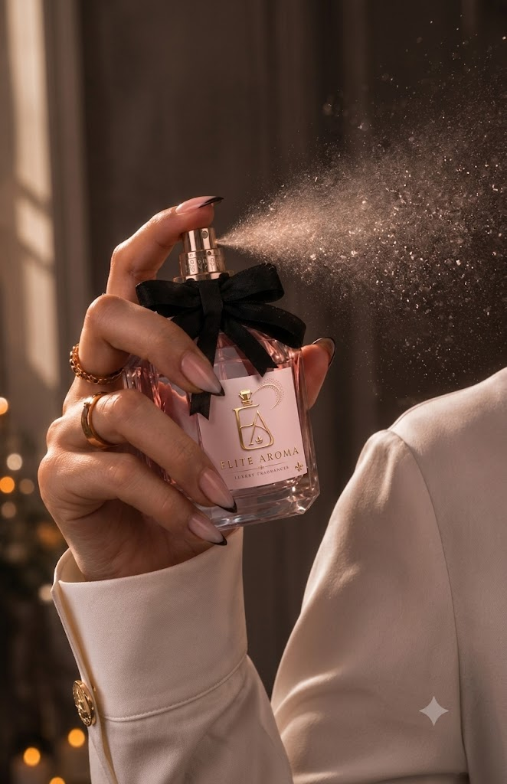
DIGITAL MARKETING ASSIGNMENT
SEO For Elite Aroma
Submitted by :- Sakshi Kotwani
BCA 3rd Sem
Session 2025 - 2028

Slide 2

Digital Marketing
Assignment Report
--------------------------------------------------------------------------------------------------------------------------------------------------------------------------------
ASSIGNMENT FOLIO
Assignment Folio of
Digital Marketing
Submitted to
Dezyne École College
Toward Digital Marketing
By
BCA
3rd Semester
Sakshi Kotwani
Dezyne École College
106/10, Civil Lines, Ajmer
www.dezyneecole.com
2026-2027
--------------------------------------------------------------------------------------------------------------------------------------------------------------------------------

Slide 3
Digital Marketing
Acknowledgement
--------------------------------------------------------------------------------------------------------------------------------------------------------------------------------
ASSIGNMENT FOLIO
We take this opportunity to express our sincere gratitude to Dezyne École College for providing us with the knowledge,
resources, and guidance essential to the successful completion of this project.
Our deepest thanks to our respected Principal, Dr. Vinita Mathur, for her visionary leadership and continuous encouragement.
Her commitment to academic excellence and student growth has been a constant source of motivation and pride.
We are equally thankful to all our faculty members for their consistent support, expert advice, and valuable insights that
shaped our learning and helped us achieve this milestone.
Lastly, we extend heartfelt thanks to everyone who directly or indirectly contributed to the success of this project.
We are proud to be part of Dezyne École College, an institution that truly nurtures professionalism, innovation, and purpose.
With sincere appreciation,
Sakshi Kotwani
Department – BCA
Dezyne École College, Ajmer
--------------------------------------------------------------------------------------------------------------------------------------------------------------------------------

Slide 4
Digital Marketing
Case Study
--------------------------------------------------------------------------------------------------------------------------------------------------------------------------------
ASSIGNMENT FOLIO
SEO Optimization
Objective:
To improve the search engine visibility, organic traffic, and overall website performance of a newly launched website by implementing effective On-Page, Off-Page, and Technical SEO strategies.
1. Website & Keyword Planning
Analyzed the website structure and performed keyword research to identify primary, secondary, and long-tail keywords based on user search intent (informational, navigational, transactional).
2. On-Page SEO Implementation
Optimized web pages using SEO-friendly URLs, title tags, meta descriptions, and proper heading structure (H1 – H3) to improve relevance and search engine ranking.
3. Off-Page SEO Activities
Built high-quality backlinks through guest posting, business listings, profile creation, social bookmarking, and forum participation to increase domain authority
4. Technical SEO Optimization
Improved page speed, mobile responsiveness, and HTTPS security, to ensure better crawling and indexing.
--------------------------------------------------------------------------------------------------------------------------------------------------------------------------------

Slide 5
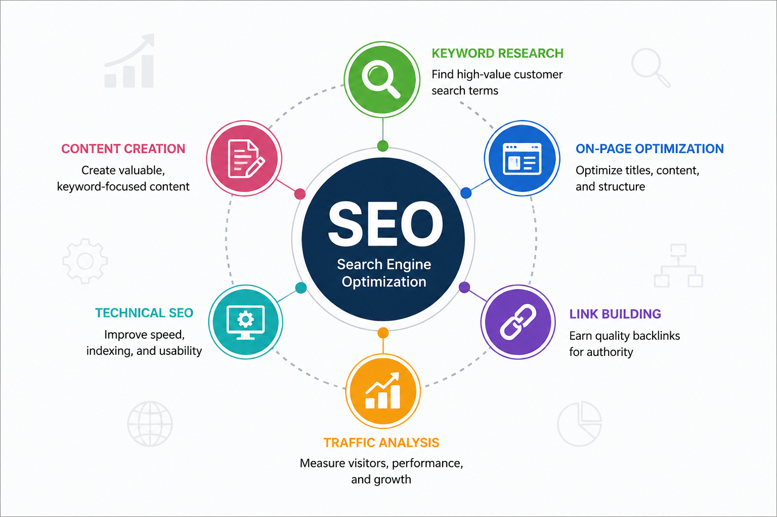
IMPORTANCE OF SEO FOR ELITE AROMA

Slide 6
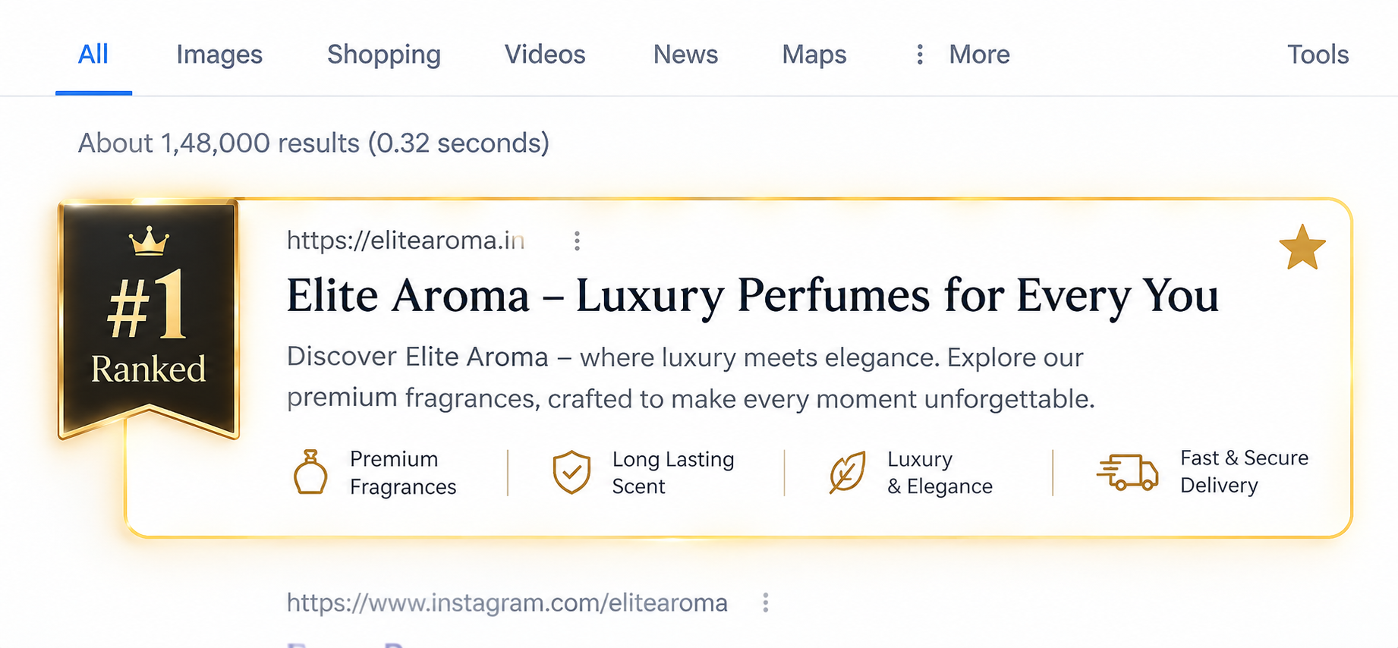
PRIMARY KEYWORD ANALYSIS
KEYWORD RESEARCH FRAMEWORK
how to make perfume last longer— Informational
best premium perfume in India — Commercial
oud perfume meaning — Informational
buy perfume for men online — Transactional
best perfume notes for summer— Informational
affordable luxury perfume online— Transactional

Slide 7
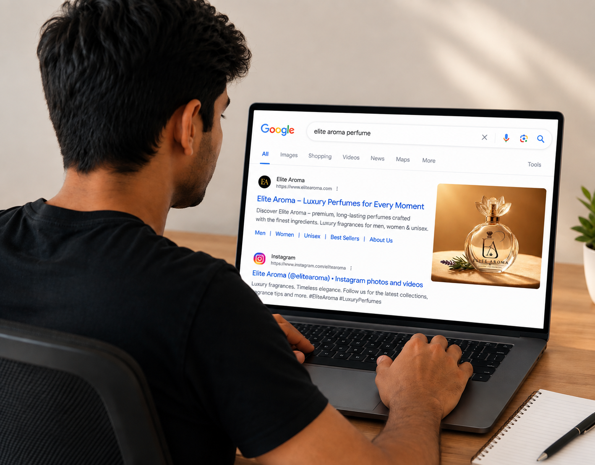
LONG-TAIL KEYWORD TARGETING
how to choose the right perfume for women — Informational
Elite Aroma perfume price in India — Transactional
Elite Aroma perfume reviews in India — Commercial
buy floral perfume for women online — Transactional
Elite Aroma perfume vs other luxury perfume brands — Commercial
order luxury perfume online India — Commercial

Slide 8
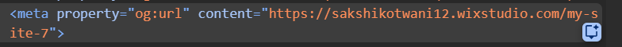
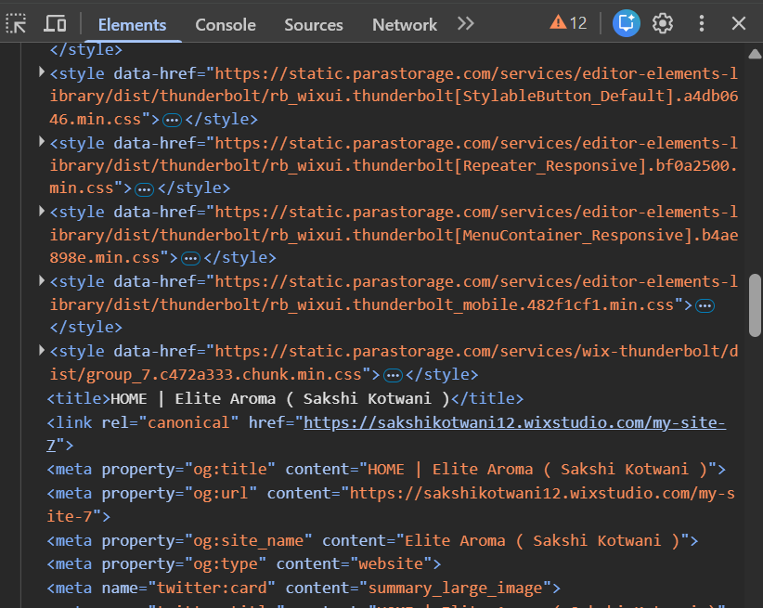
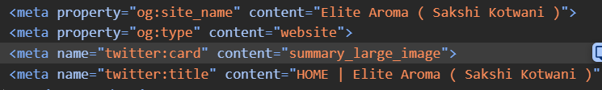
ON-PAGE SEO
Page-Level Optimization
Title Tag →
<title>Home | Elite Aroma</title>
URL STRUCTURE →
Meta Description →

Slide 9
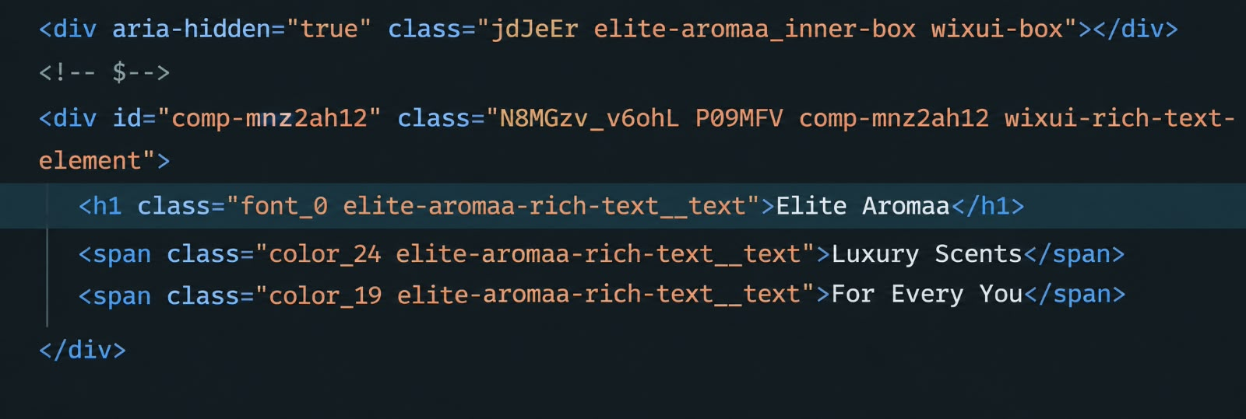
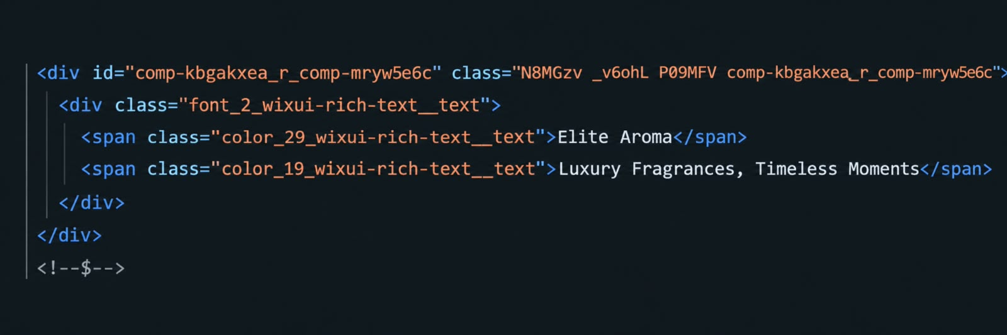
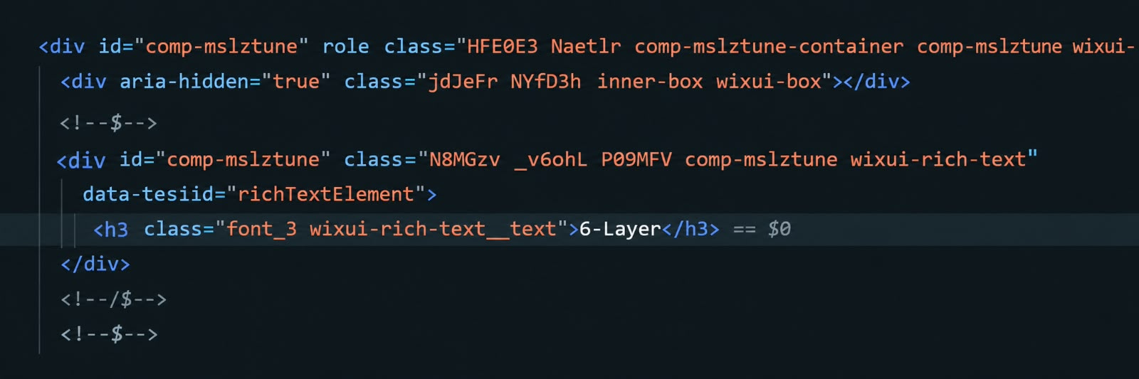
HEADING HIERARCHY
H1: Page title with primary keyword
H2: Section headings for key topics
H3: Sub-sections and supporting content

Slide 10
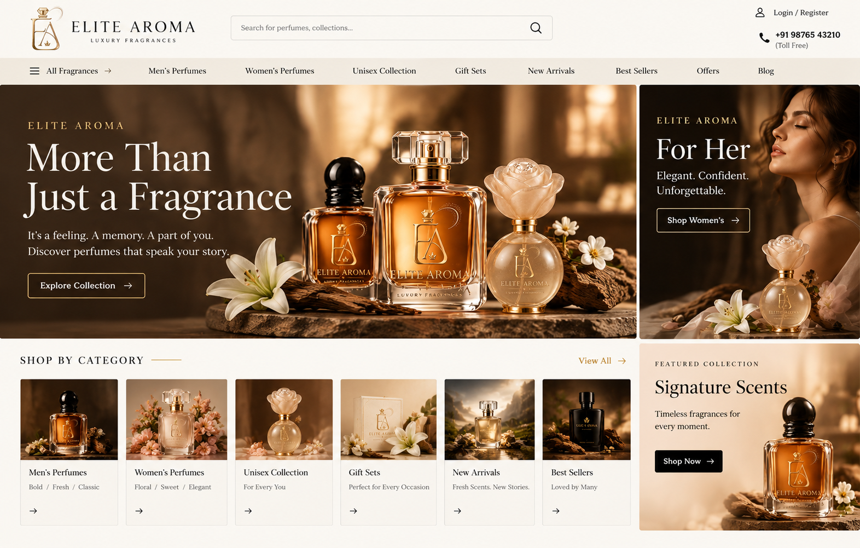
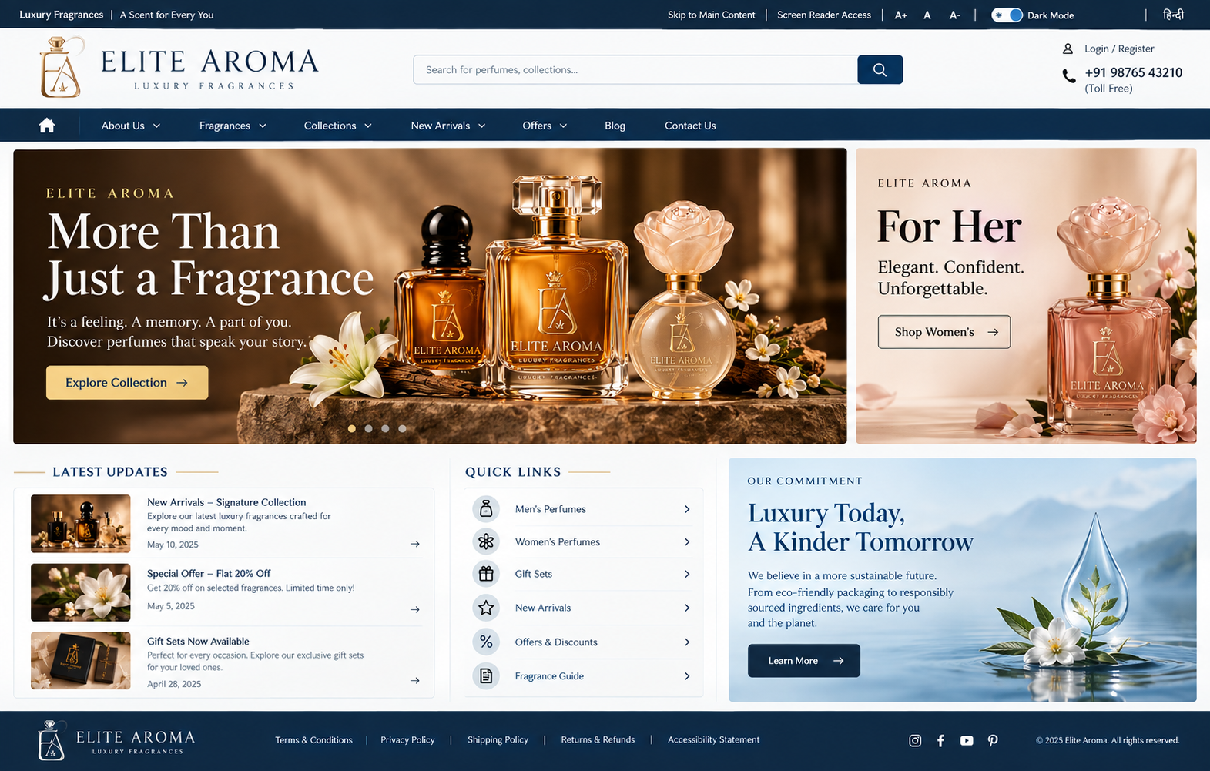
OFF-PAGE SEO
Backlink Building
  Perfume & Fragrance → FragranceX
  Fashion & Lifestyle → Myntra
  Beauty & Personal Care → Nykaa
  Beauty & Grooming → Purplle

Slide 11
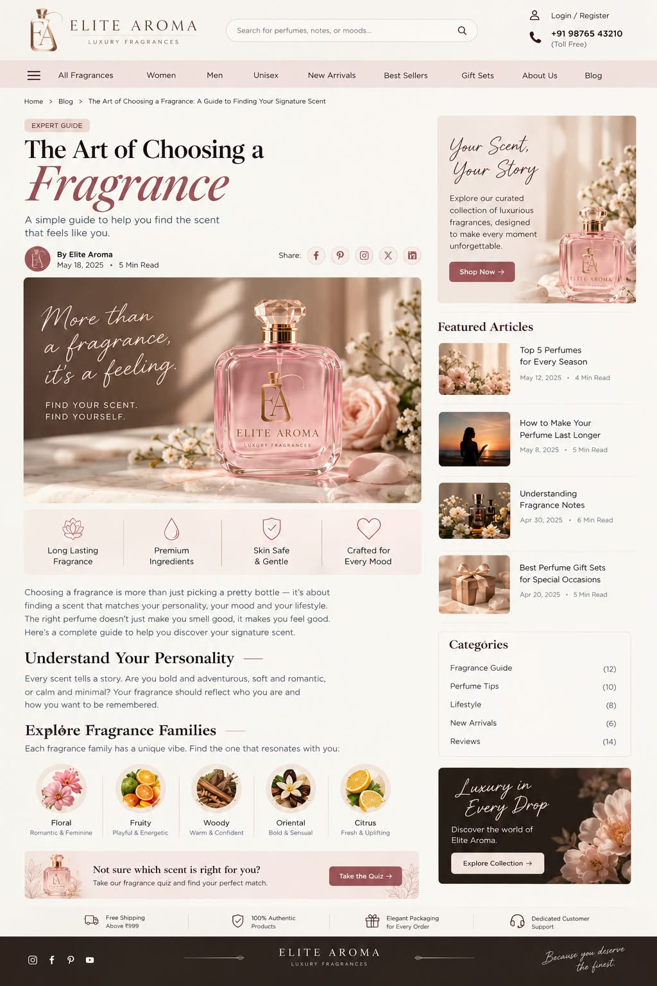
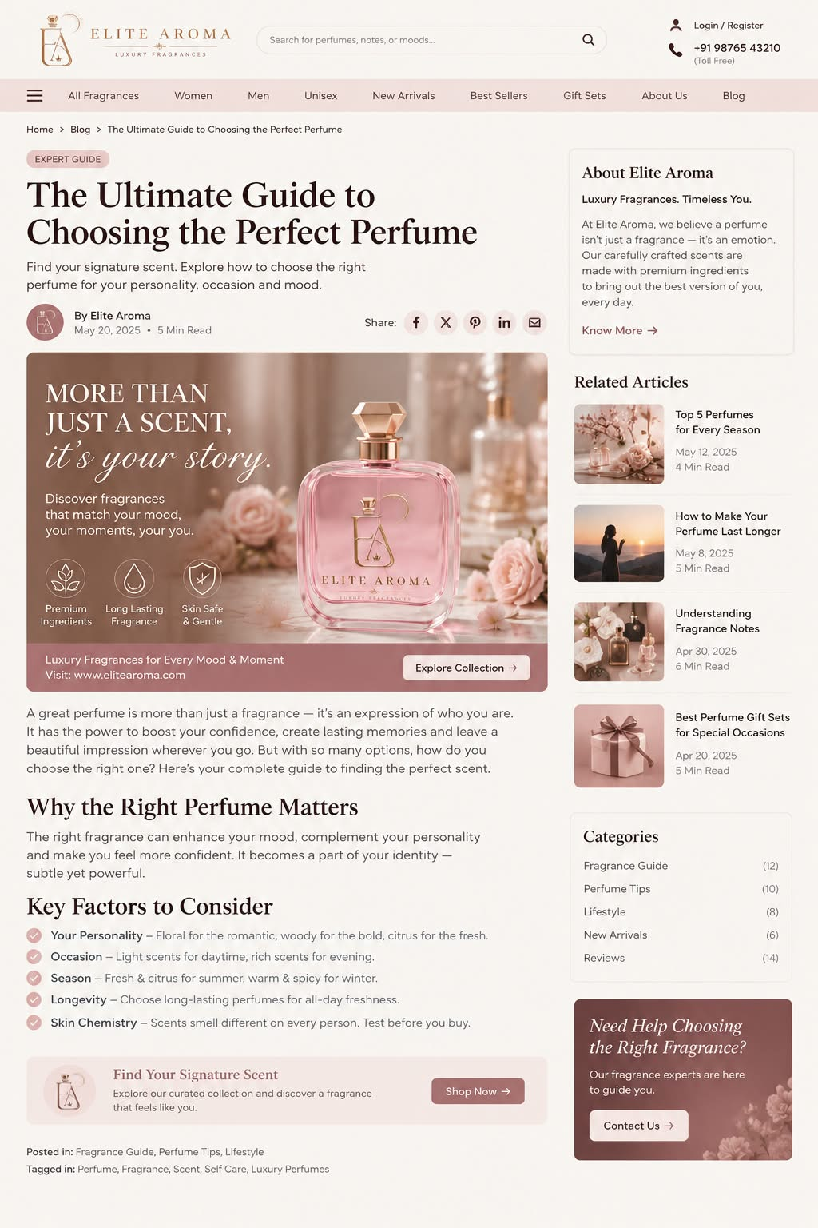
Guest Posting
  “Your signature scent starts here.”
  “Luxury in every drop, memories in every fragrance.”

Slide 12
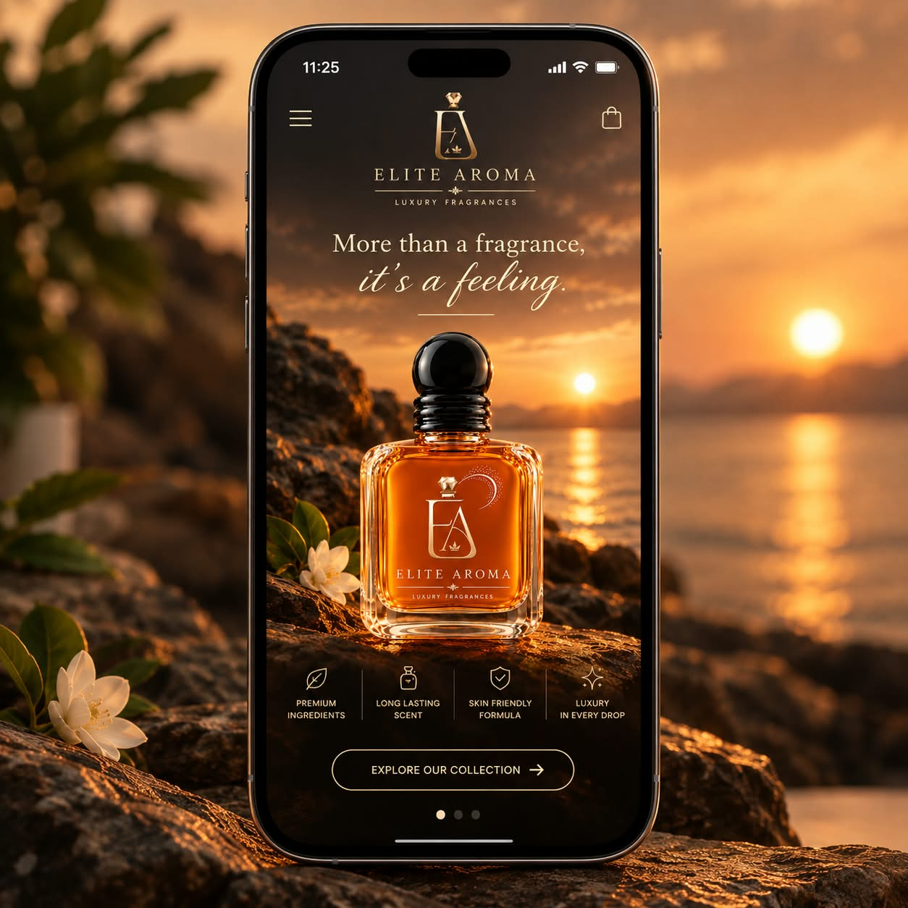
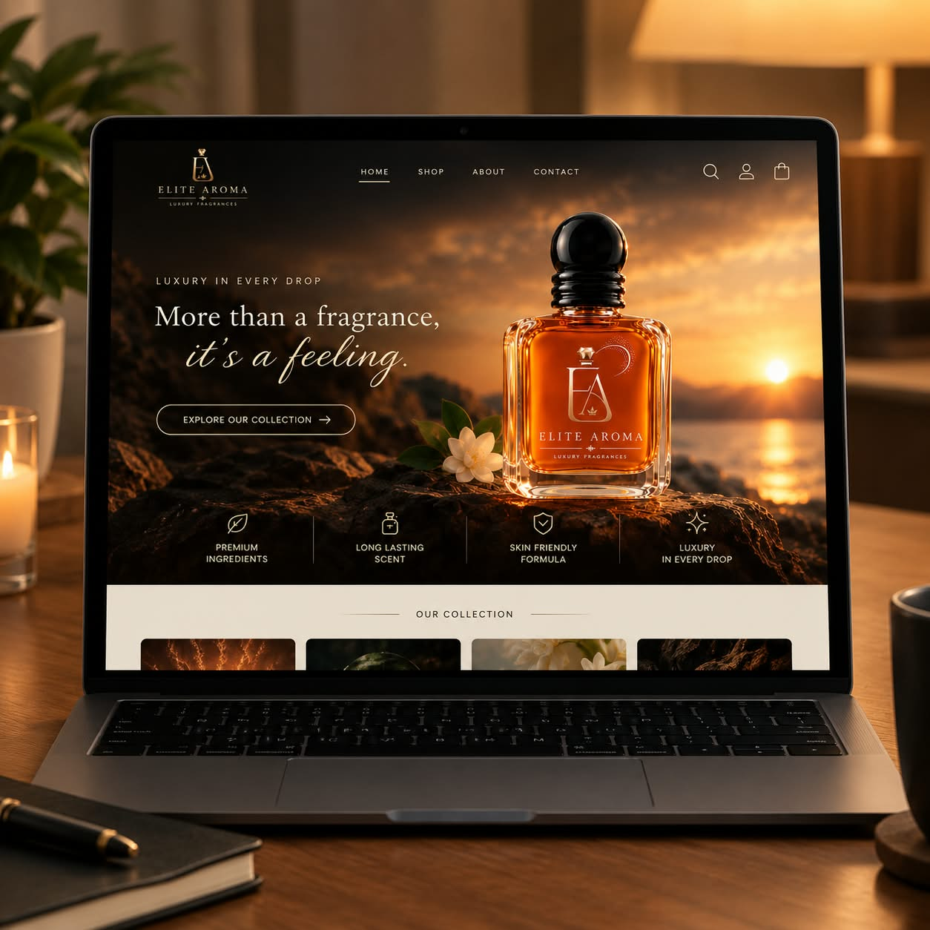
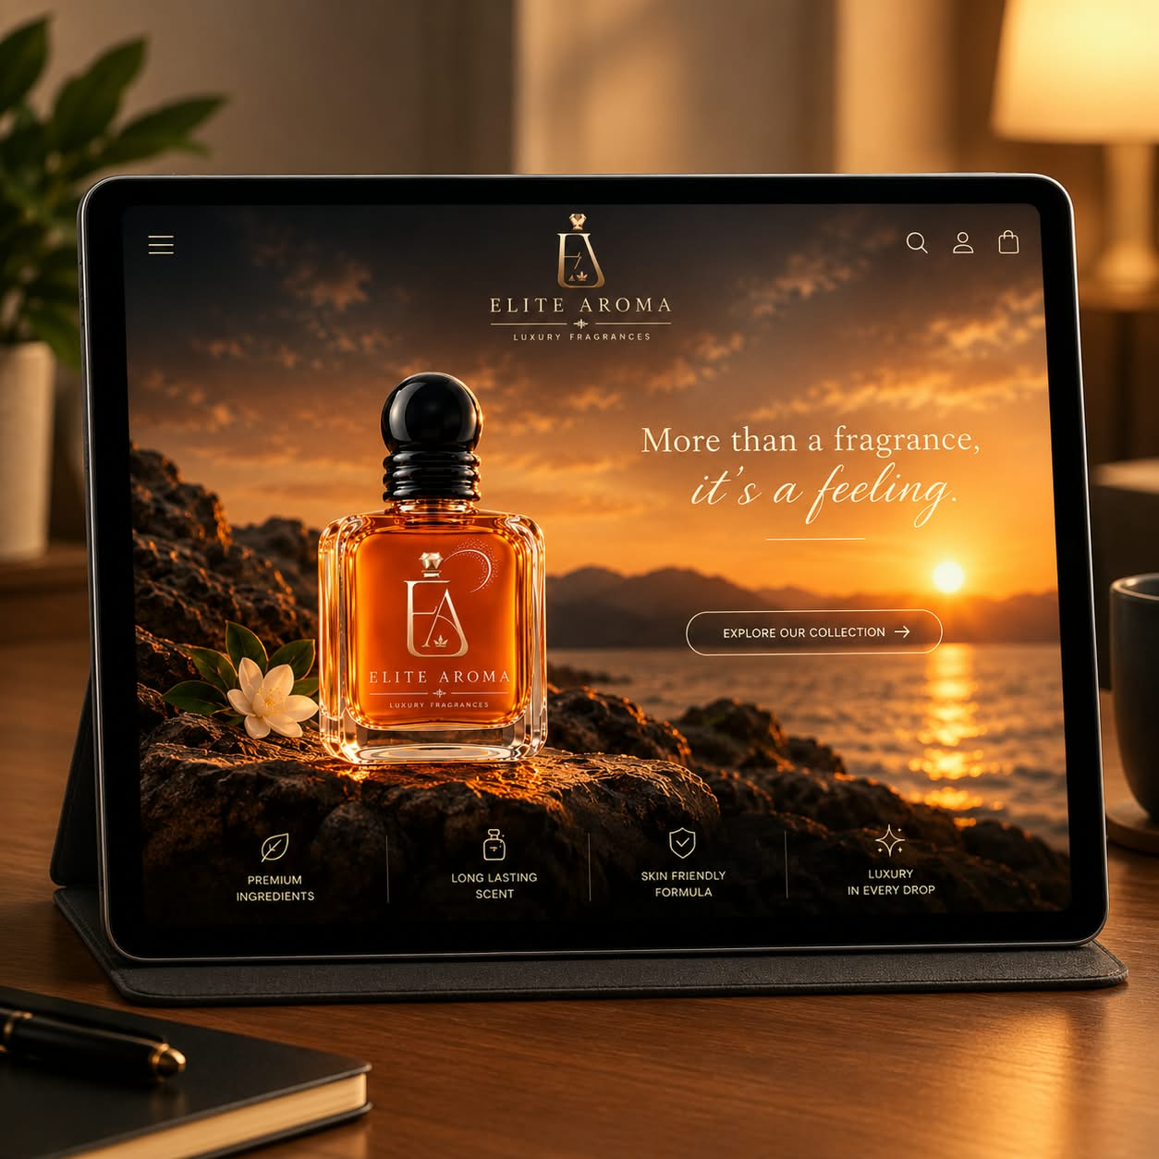
RESPONSIVENESS
Phone View
Laptop View
Tablet View

Slide 13
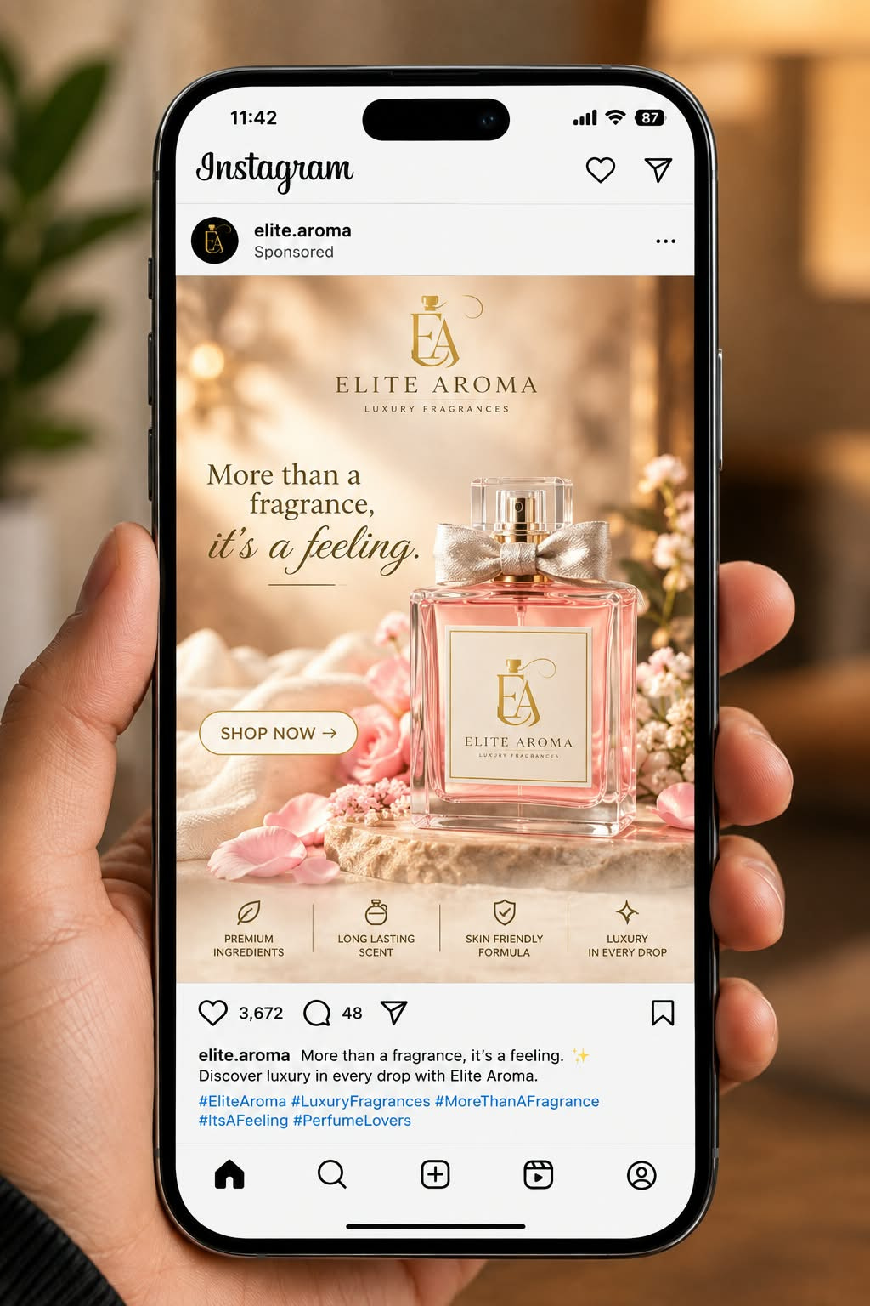
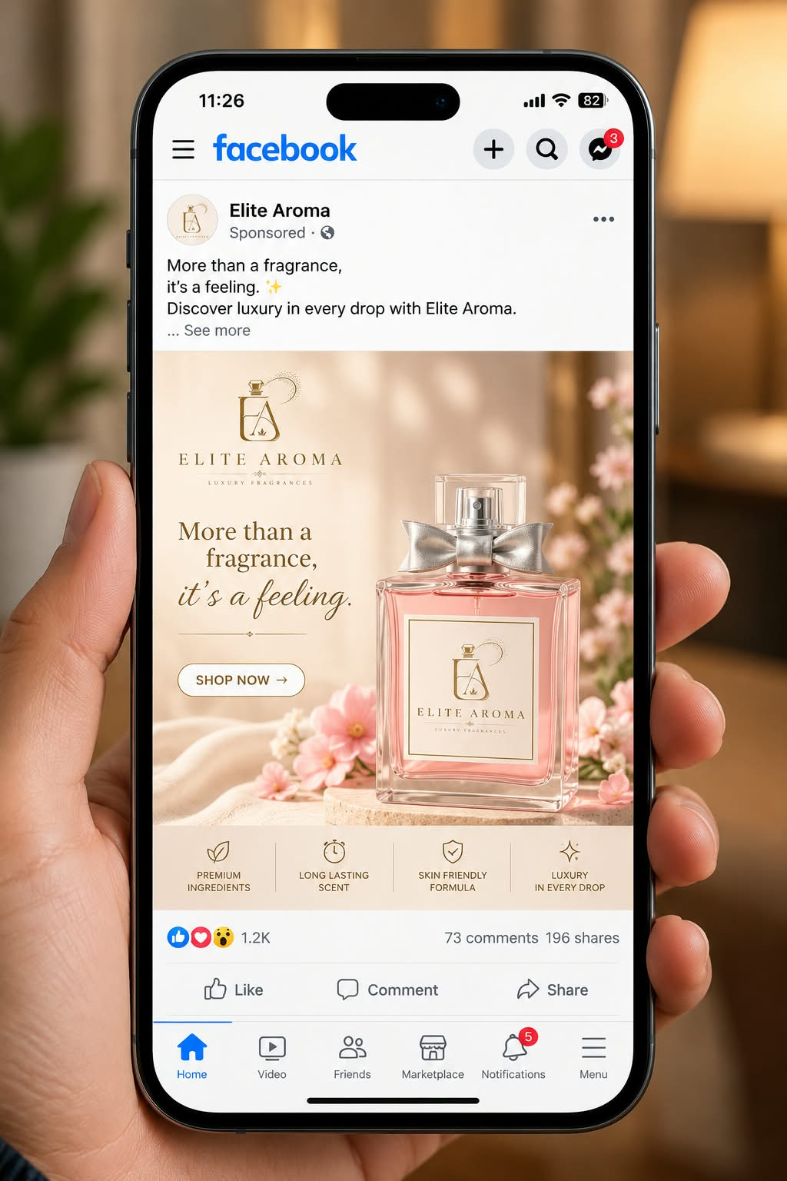
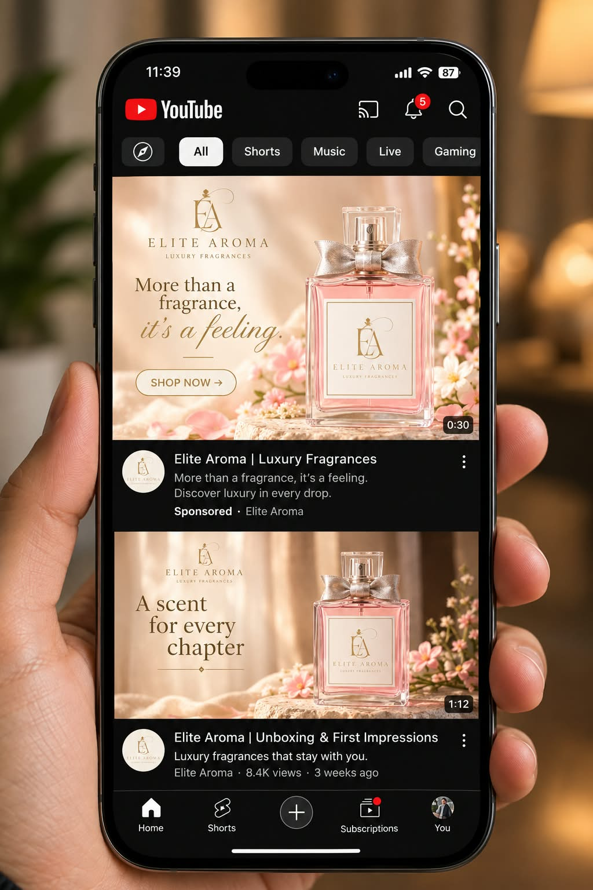
Social Media
Instagram
Facebook
YouTube

Slide 14
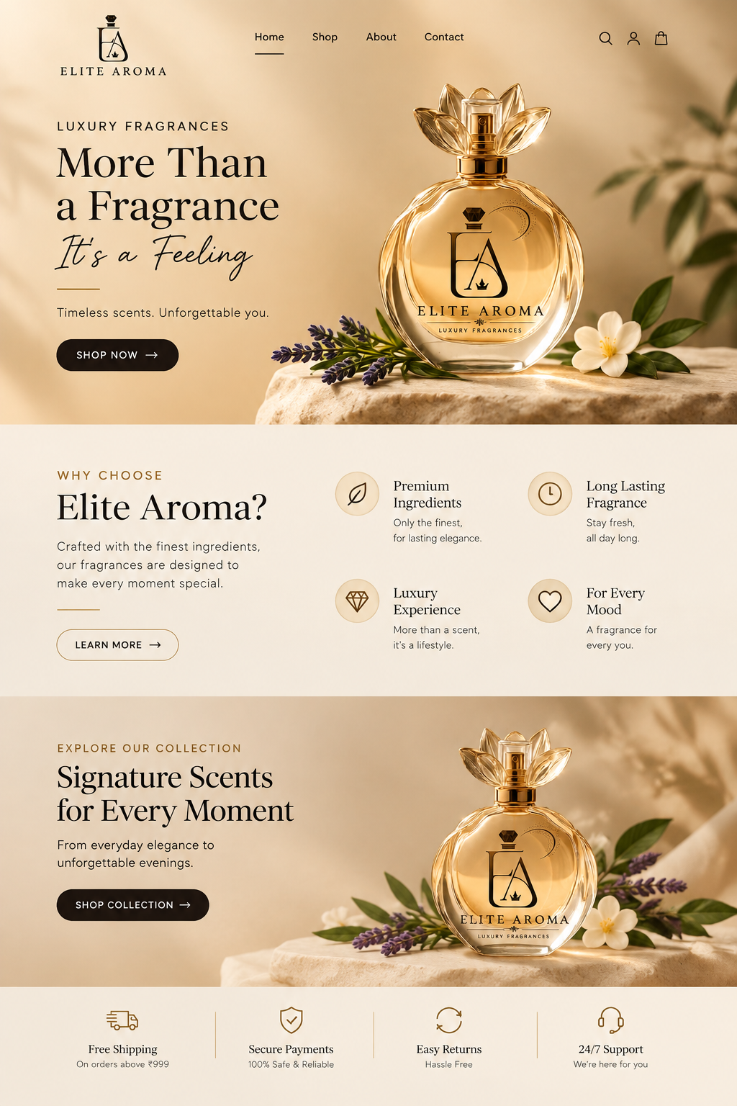
IMPROVEMENT SUGGESTIONS
1. Technical SEO Speed
Improve website loading speed, mobile responsiveness, and crawlability to enhance user experience and search engine rankings.
2. Content & Keyword Optimization
Create keyword-focused blogs, product pages, and FAQs targeting water tanks, water storage, and water conservation search queries.
3. User Experience Enhancement
Improve website navigation, add clear call-to-action buttons, optimize mobile usability, and display customer reviews to enhance user experience and increase conversions.

Slide 15
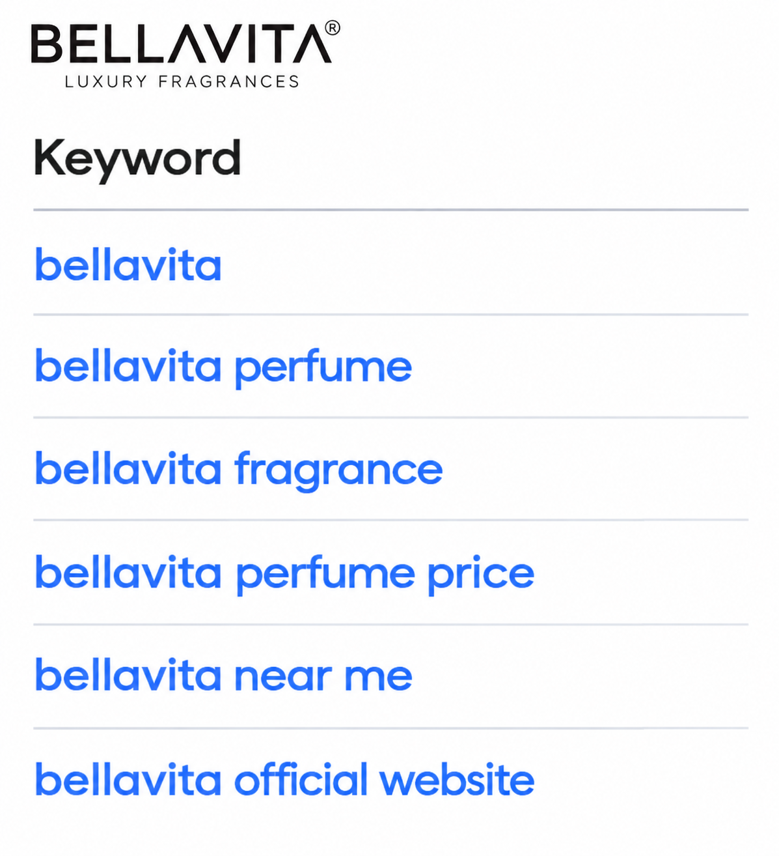
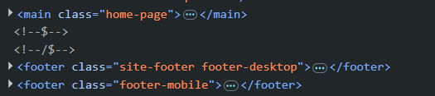
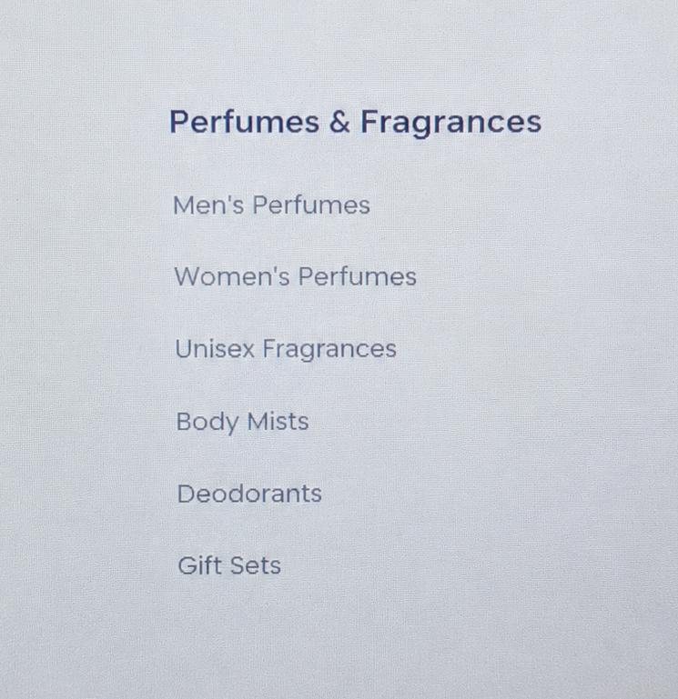
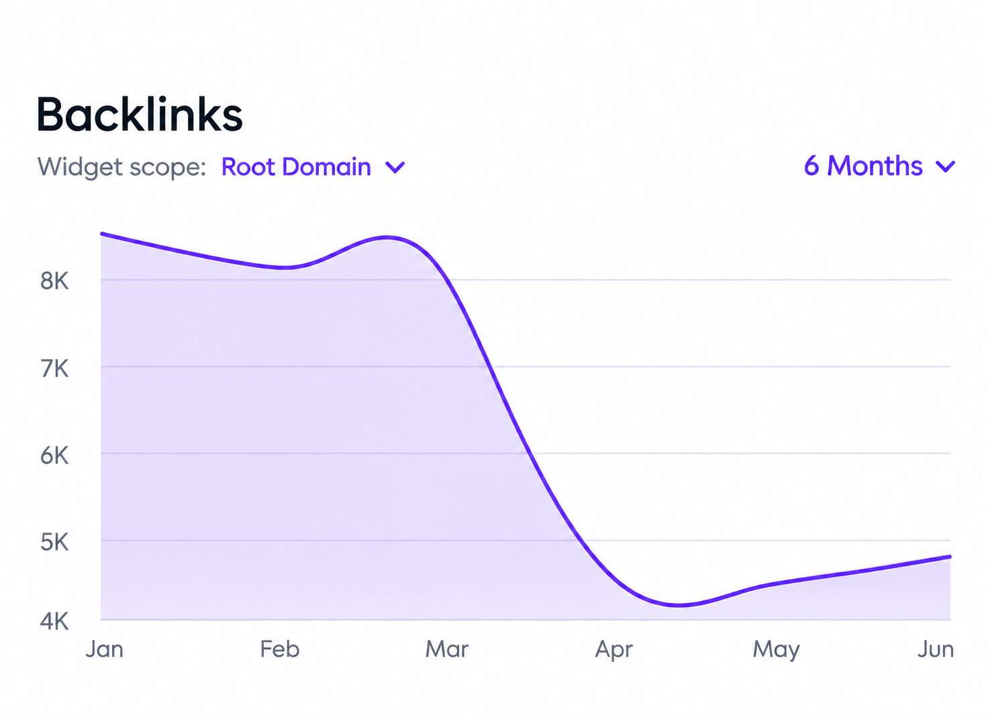
COMPETITION Analysis
ELITE AROMA VS BELLAVITA— SEO
Keyword Strategy
Domain Authority
Elite Aroma : premium perfumes, luxury fragrances
Bellavita : perfumes, perfumes for men, perfumes for women
Elite Aroma: New / Developing Brand
Bellavita: ~33 (Established Brand)
Content Strategy
Elite Aroma: Focused, long-tail & conversion-oriented content strategy
Bellavita: Broad & established content strategy

Slide 16
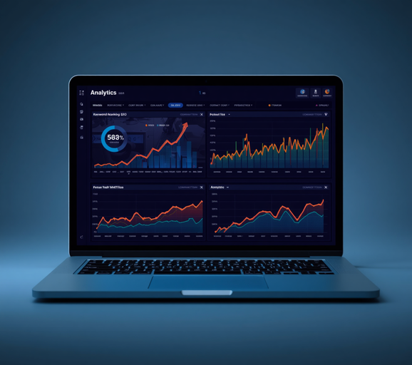
CONCLUSION
SEO strategy drives Elite Aroma's digital growth, visibility, and market expansion.
Key Takeaways
On-page & technical SEO optimize performance, crawlability, and search engine rankings effectively.
Future SEO Growth
Off-page strategies and competitor insights accelerate Elite Aroma's brand authority and market reach.
SEO Success Factors
• Keyword Targeting
• On-Page SEO
• Off-Page SEO
• Technical SEO

Slide 17


